Slide 1
Management of Technology

Slide 2
What is Management ?
What it technology?

Slide 3




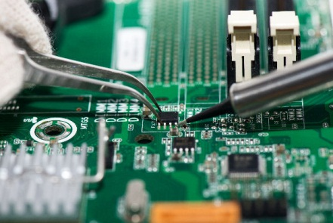
Technology:
In simple terms, Technology is the way we do
things. A practical implementation of knowledge , a means of aiding human endeavour
Technology is not only hardware , but consists of 3 interdependent codetermining and equally important components:-
Hardware
Software
Brain ware (Know why)

Slide 4
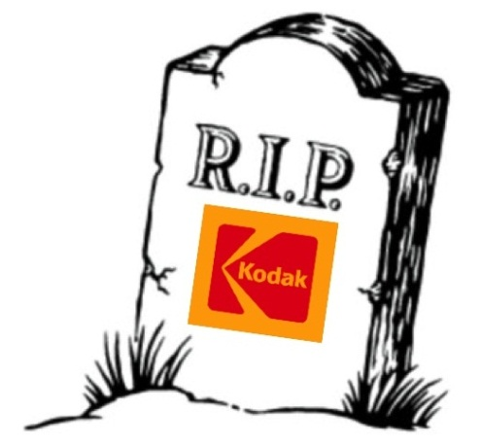
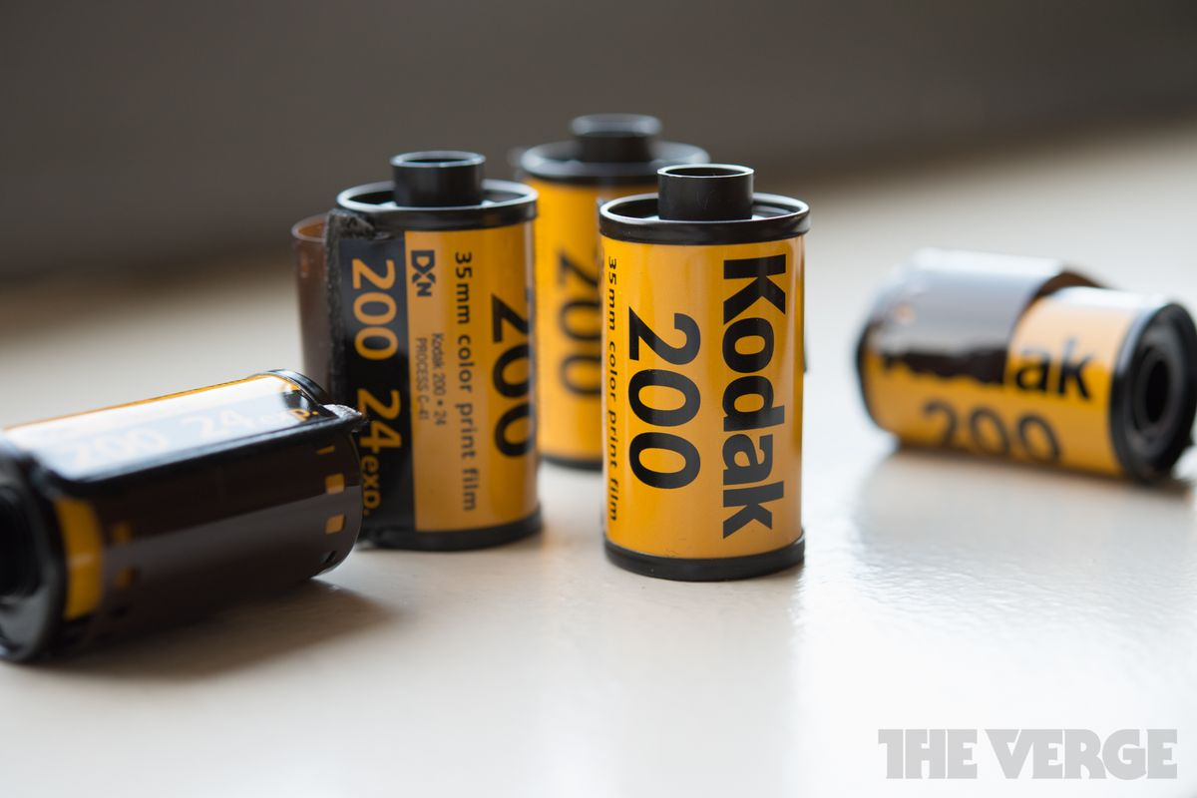
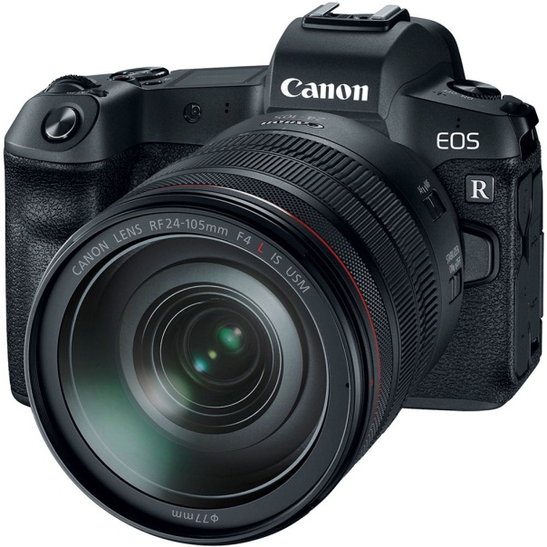
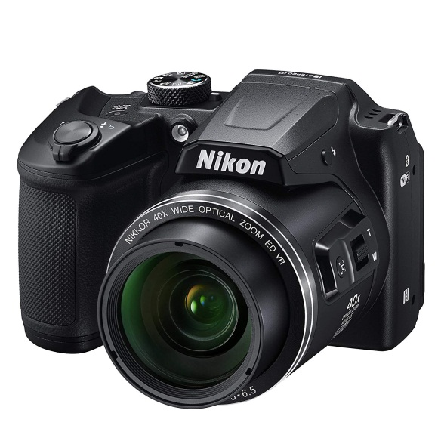
What went wrong with Kodak?

Slide 5
Filed for bankruptcy protection in 2012
Because of Sluggish response to adapt modern technology
Learning's:
Marketing is not the art of selling products
Marketing is tasked with keeping the company relevant to their customers’ needs

Slide 6
Critical factors in managing technology
Invention(A new composite material, a completely new software, a new manufactured product- An idea which is new to the world)
Innovation(First use of an idea in an organization not new to the world, it may be a change in industrial practice which may improve productivity or a change in marketing which may increase sells)
Timing (Timing of introducing follow up technology to the market place)
Case Study: Tata Nano

Slide 7
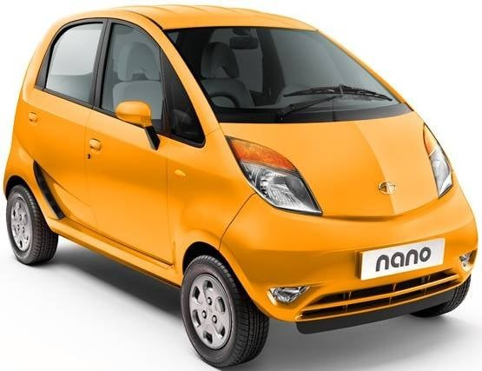
Design innovation (instrument cluster at the center of dashboard , one wiper)
Material Innovation(wheels at the extreme edge of the car frame)
Supply Chain innovation(modular kits , using third party to reach customers)

Slide 8
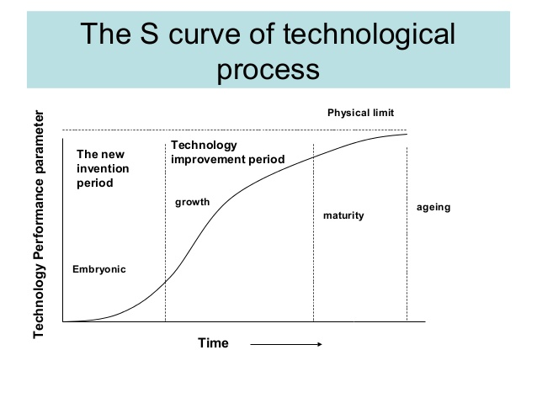
Technology life cycle

Slide 9
Process of technological innovation:
Basic research(Scientific discovery)
Applied research(solving problems with basic research)
Technological development(Prototype)
Technology implementation( Successful commercial introduction-cost, safety, environmental consideration )
Production
Marketing(market assessment , distribution, promotion, measuring consumer behavior)
Proliferation(widespread use and dominance)
Technology enhancement

Slide 10
Technology Audit model(TAM)
6 categories:
Technological environment
Technological categorization
Competitors and markets
Innovation process
Value added functions
Acquisition and exploitation of technology

Slide 11
Acquisition of technology
Using internal R&D
Participating in joint venture
Contracting out for R&D
Licensing of technology
Buying the technology

Slide 12
5 factors upon which a company can make acquisition decision
Companies relative standing in the technology
Urgency of acquisition
Level of commitment to the acquisition
Technology position on the life cycle
The classification of the technology.

Slide 13
Technology Transfer
International
Regional
Cross industry
Interfirm
Intrafirm

Slide 14
Case study:
Hero -honda, kodak,Tata steel & corus,Tata nano,Xerox

Slide 15


